Slide 1

Custom Validators & Directives
Timmy Tom Tata Consultancy Services

Slide 2
Who’s Timmy

Slide 3
Custom Validator and use it in a Reactive Form
Accessing ‘ValidationErrors’ for a FormControl to show Validation Messages
Custom Validator with dependencies and use it in a Reactive Form
Custom Validator Directive for Model driven Form
Multi Providers & Forward References in Angular

Slide 4
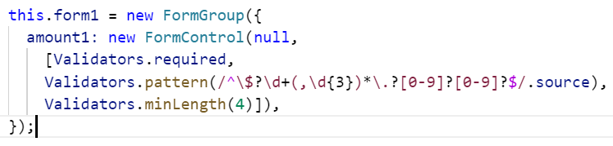
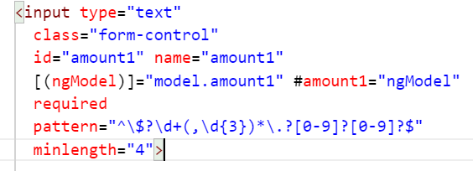
Validator:
A validator is a function that processes a FormControl and returns a map of errors. Every time the value of a form control changes, Angular runs validation and generates either a list of validation errors, which results in an INVALID status, or null, which results in a VALID status.
Reactive Form
Model Driven Form

Slide 5
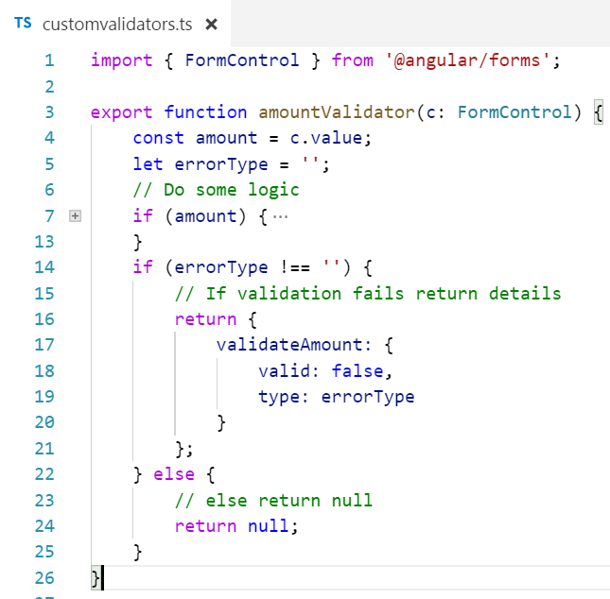
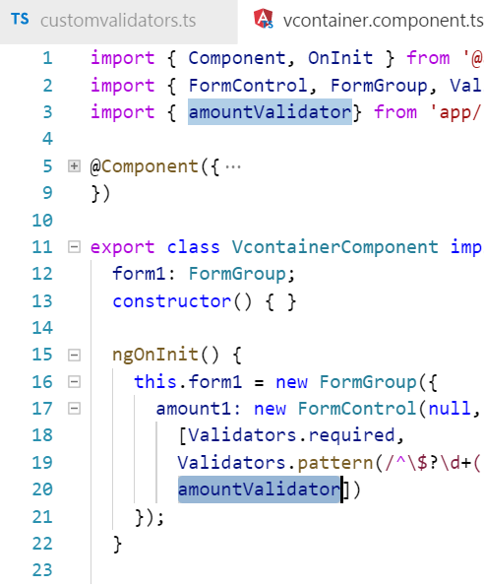
Custom Validator
in Reactive Form

Slide 6
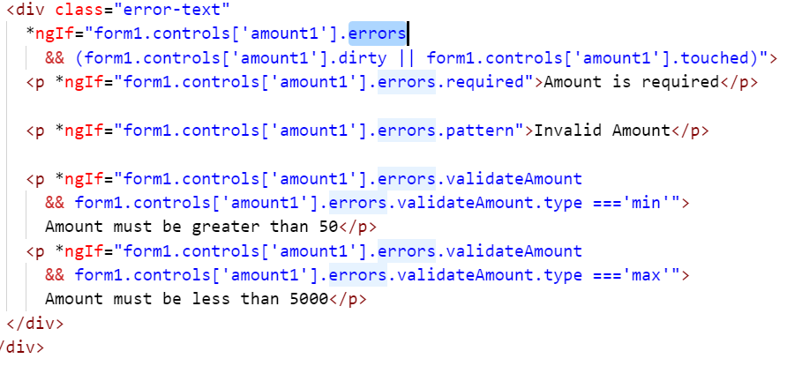

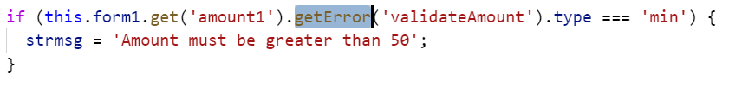
Accessing FormControl ‘ValidationErrors’

Slide 7
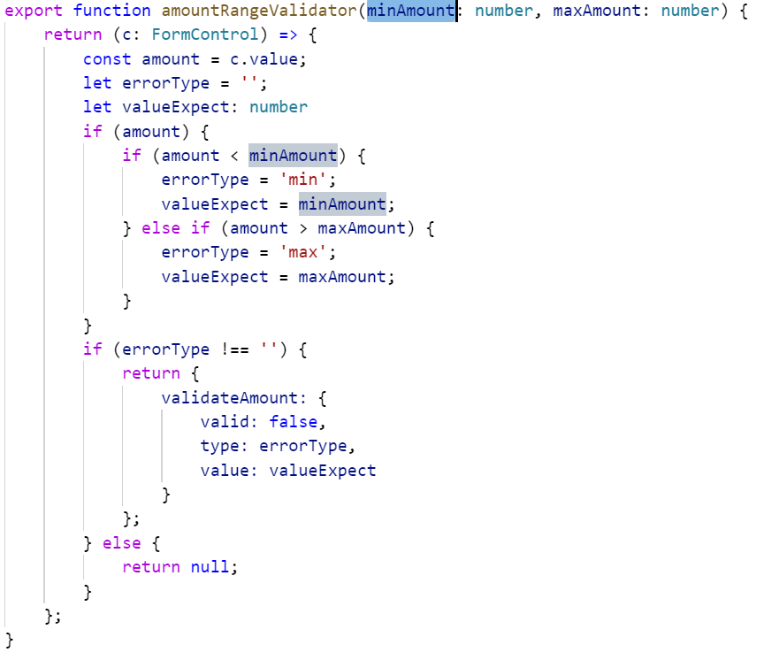
Custom Validator with dependency

Slide 8
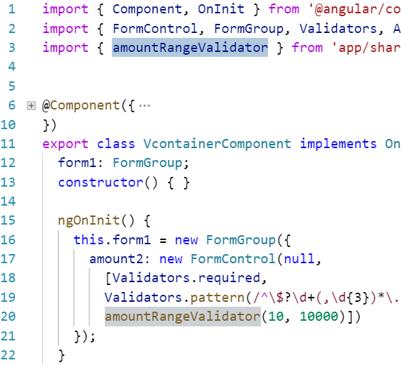
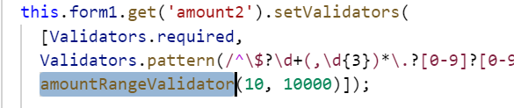
Calling Custom Validator with dependency in Reactive Form

Slide 9
Directives
Components - directives with a template <my-custom-component-dir></my-custom-component-dir>
Structural Directives - change the DOM layout by adding and removing DOM elements. <p *ngIf="form1.controls['amount1'].errors.pattern">Invalid Amount</p> <ul> <li *ngFor="let hero of heroes">{{hero.name}}</li> </ul>
Attribute Directives - change the appearance or behavior of an element, component

Slide 10
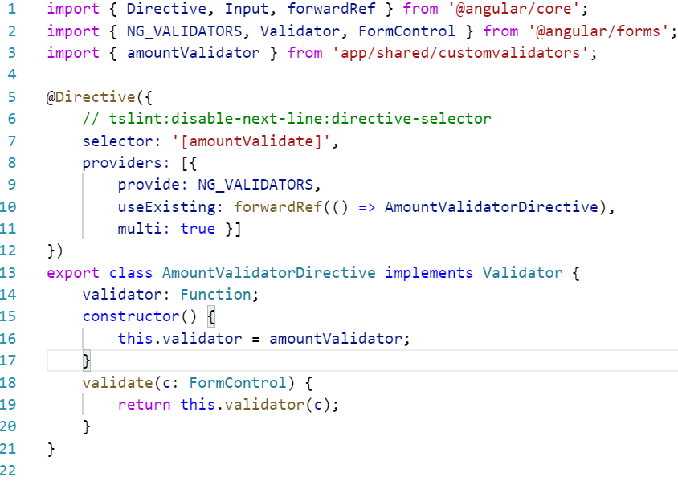
Custom Directive using Custom Validator without dependency
Directive
Validator
NG_VALIDATORS

Slide 15
Thank You
https://angular.io/guide/form-validation
https://blog.thoughtram.io/angular/2016/03/14/custom-validators-in-angular-2.html#custom-validators-with-dependencies

